Slide 1
RESTAURANTS IN CHICAGO: - OPTION OF NEW BUSINESS…..

Slide 2
INTRODUCTION
In this project, we look at the restaurants available in the city of Chicago. Here, we are going to explore, segment and cluster the restaurants in the city of Chicago. The data is analysed to see the different restaurants available in the particular place and where we would recommend one to open a restaurant if they are trying to start their own business of opening a restaurant.

Slide 3
METHODOLOGY
Foursquare API to locate the restaurants in different location of Chicago.
Classify the restaurant in each location, atleast for one location, say Chicago.
Analyse the total number of restaurant in each location.
Decide the places for new business.

Slide 4
RESULTS

Slide 5
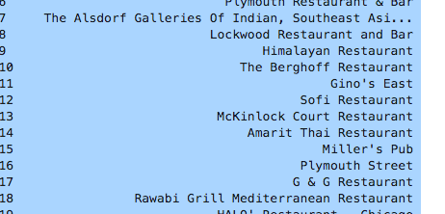
LOCATION OF RESTAURANTS

Slide 6
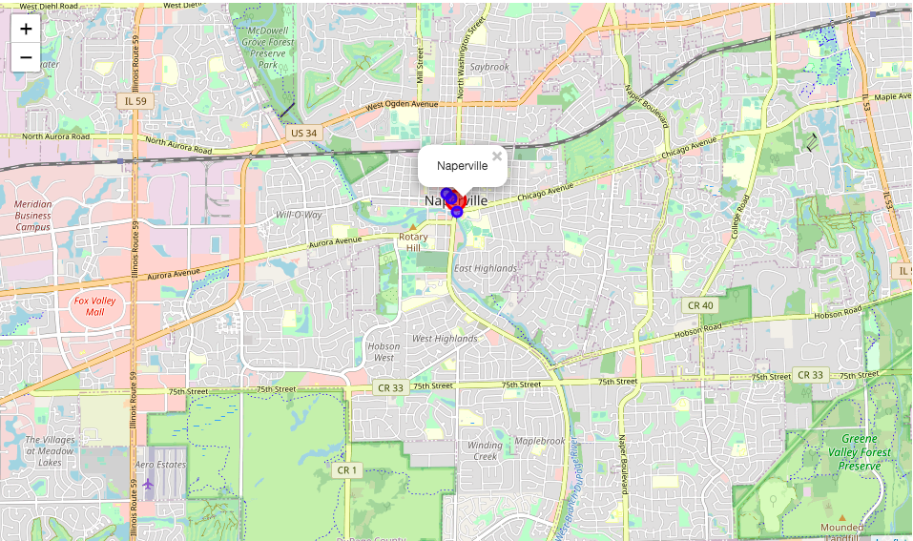
LOCATION OF RESTAURANTS

Slide 7
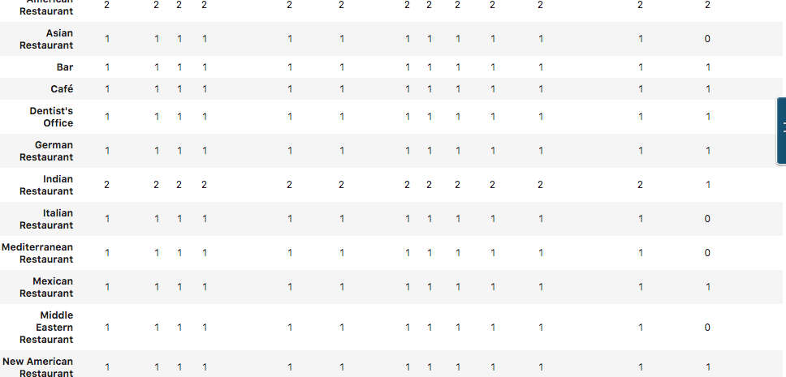
Classify the restaurant in CHICAGO

Slide 8
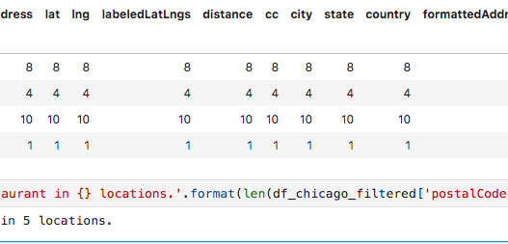
TOTAL NUMBER OF RESTAURANT IN EACH LOCATION IN CHICAGO

Slide 9
Conclusion
To conclude, the restaurants available in Chicago area are identified with its venue location using API foursquare and the data has been interpreted and analysed for various categories of restaurants and number of restaurants in with its postal code. In future, more research on data collection will be done and the same will be classified using any classification algorithms.

Slide 11
THANK YOU!!!1

